Slide 1
A user interface for landscape modeling in a virtual environment using a head mounted display
Timothy Gwynn

Slide 2
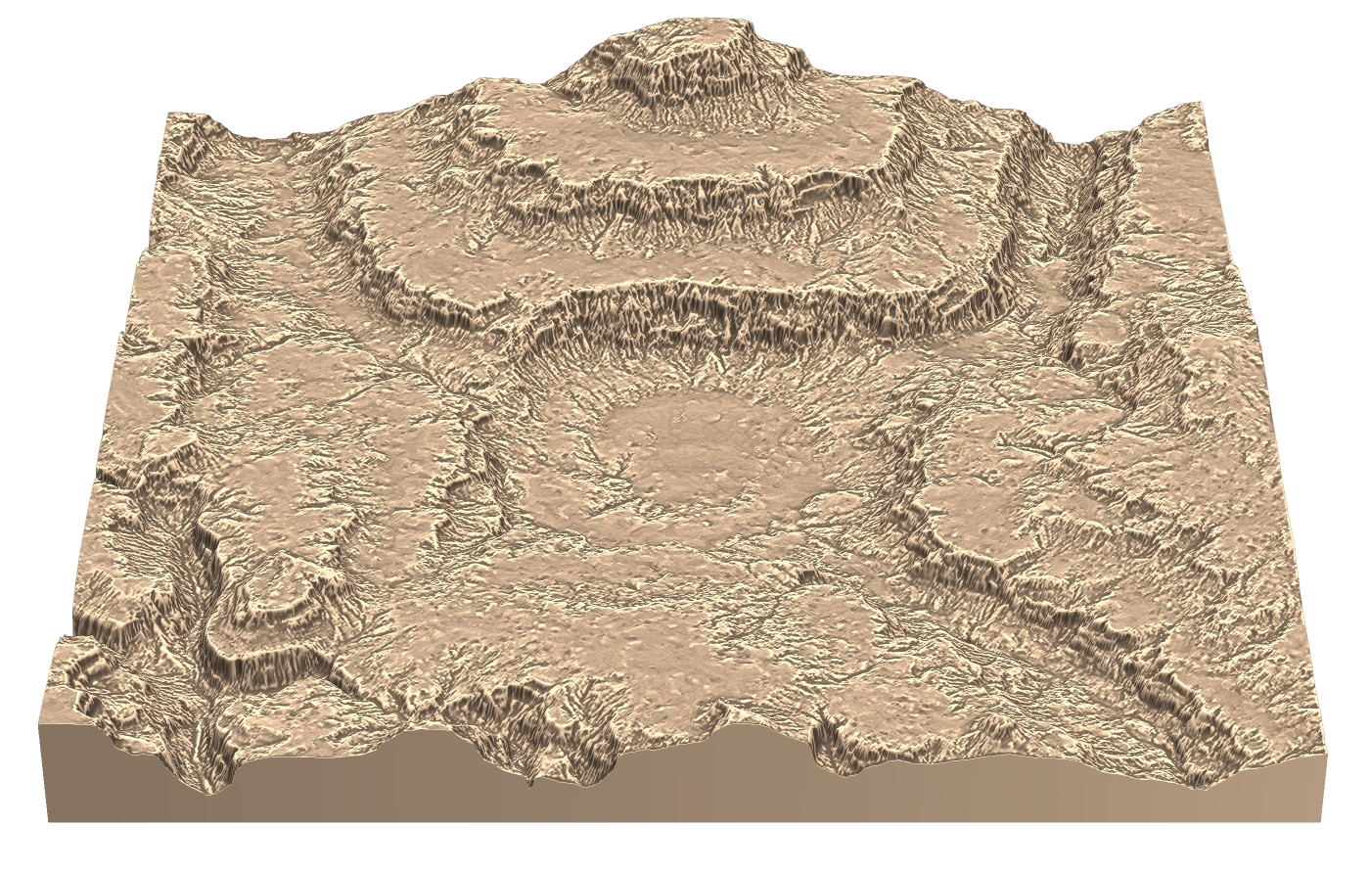
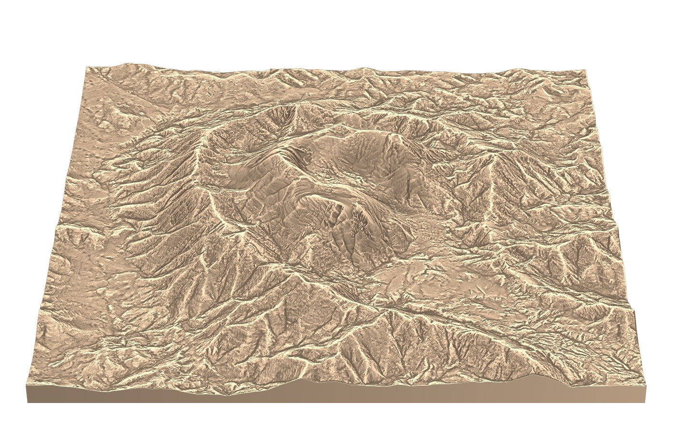
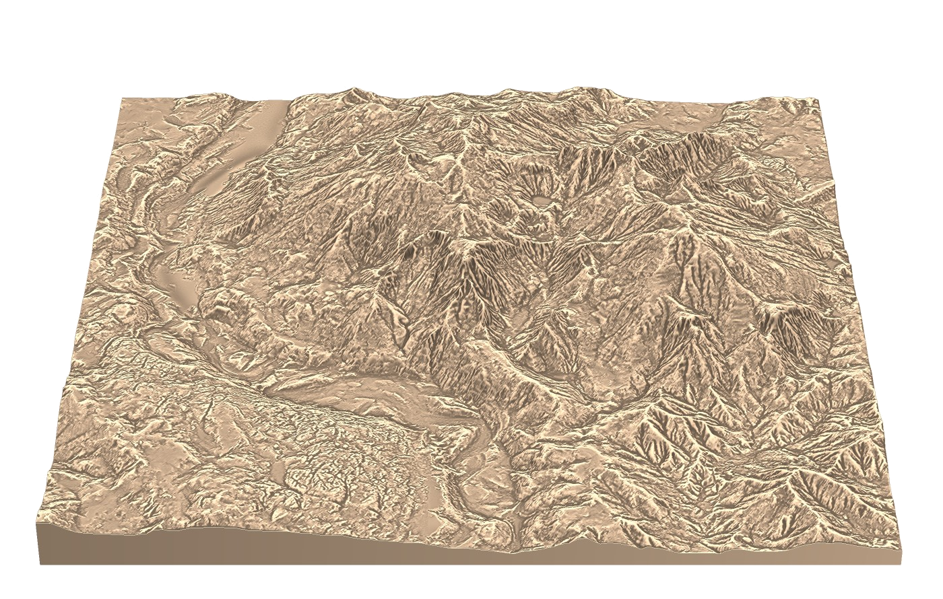
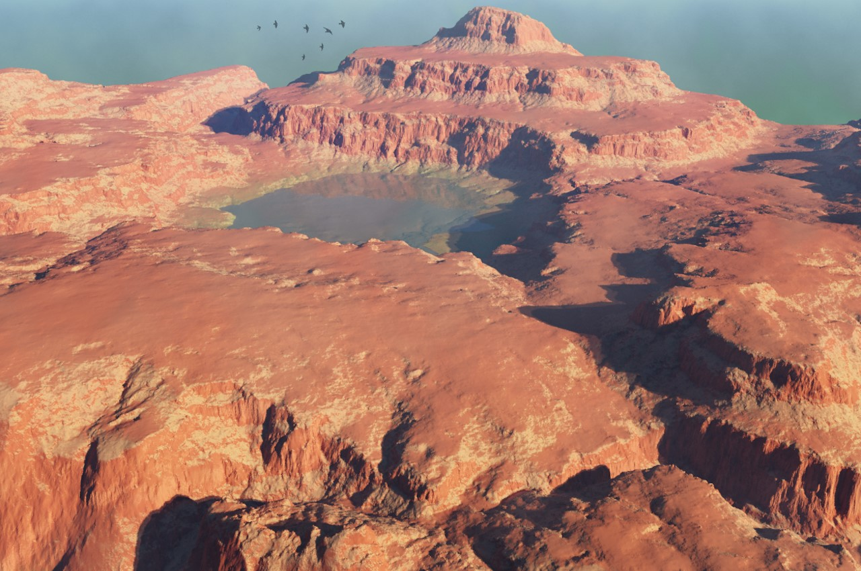
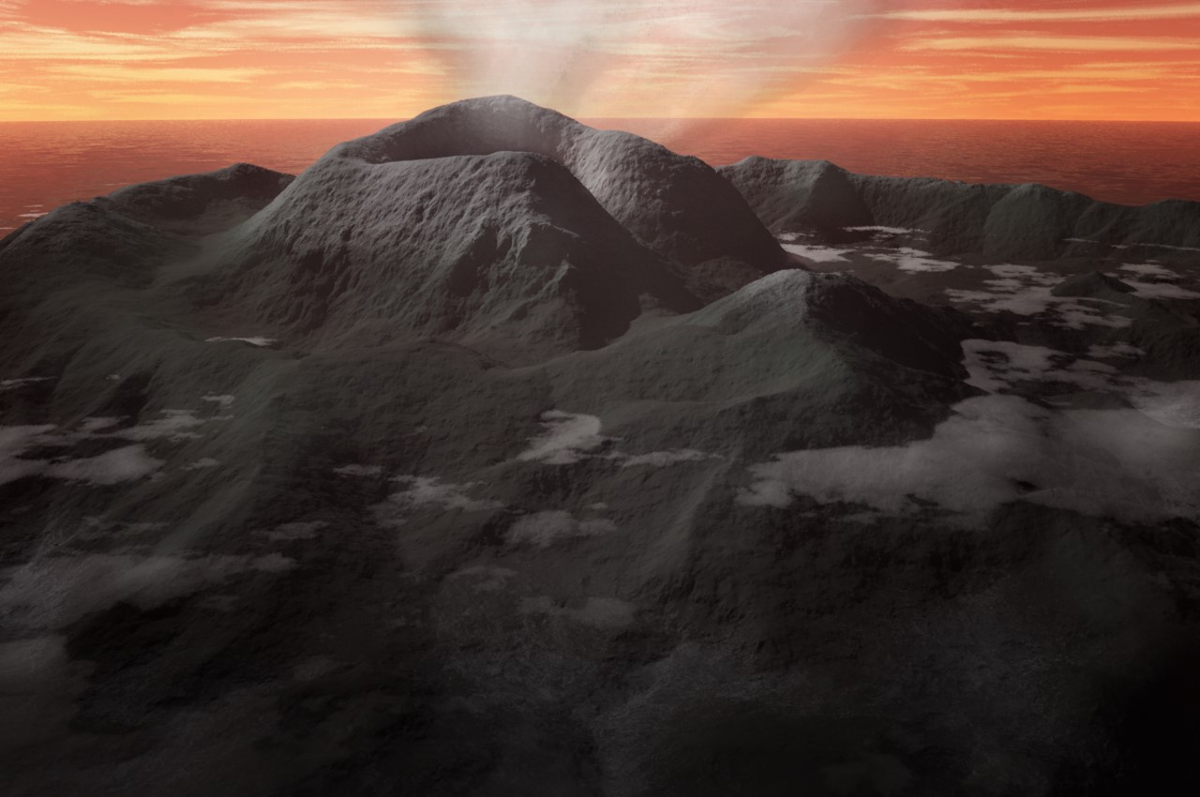
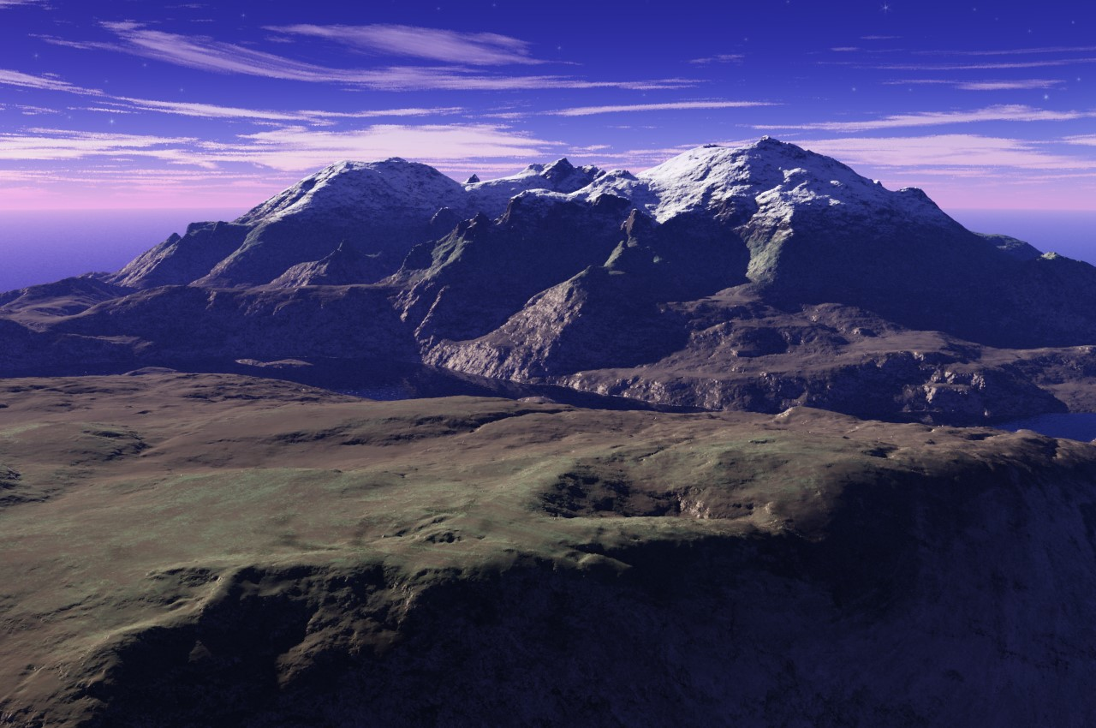
Terrain Modeling and UTS
Allows for real-time editing with realistic terrain synthesis
Hybrid interface includes 3D widgets, sketching and painting
Desktop application

Slide 3
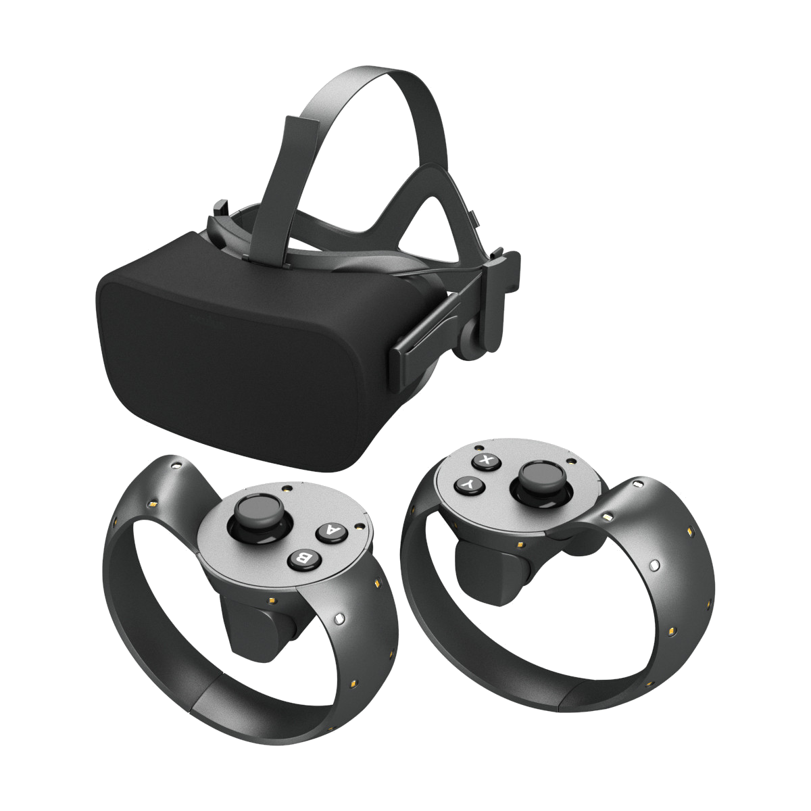
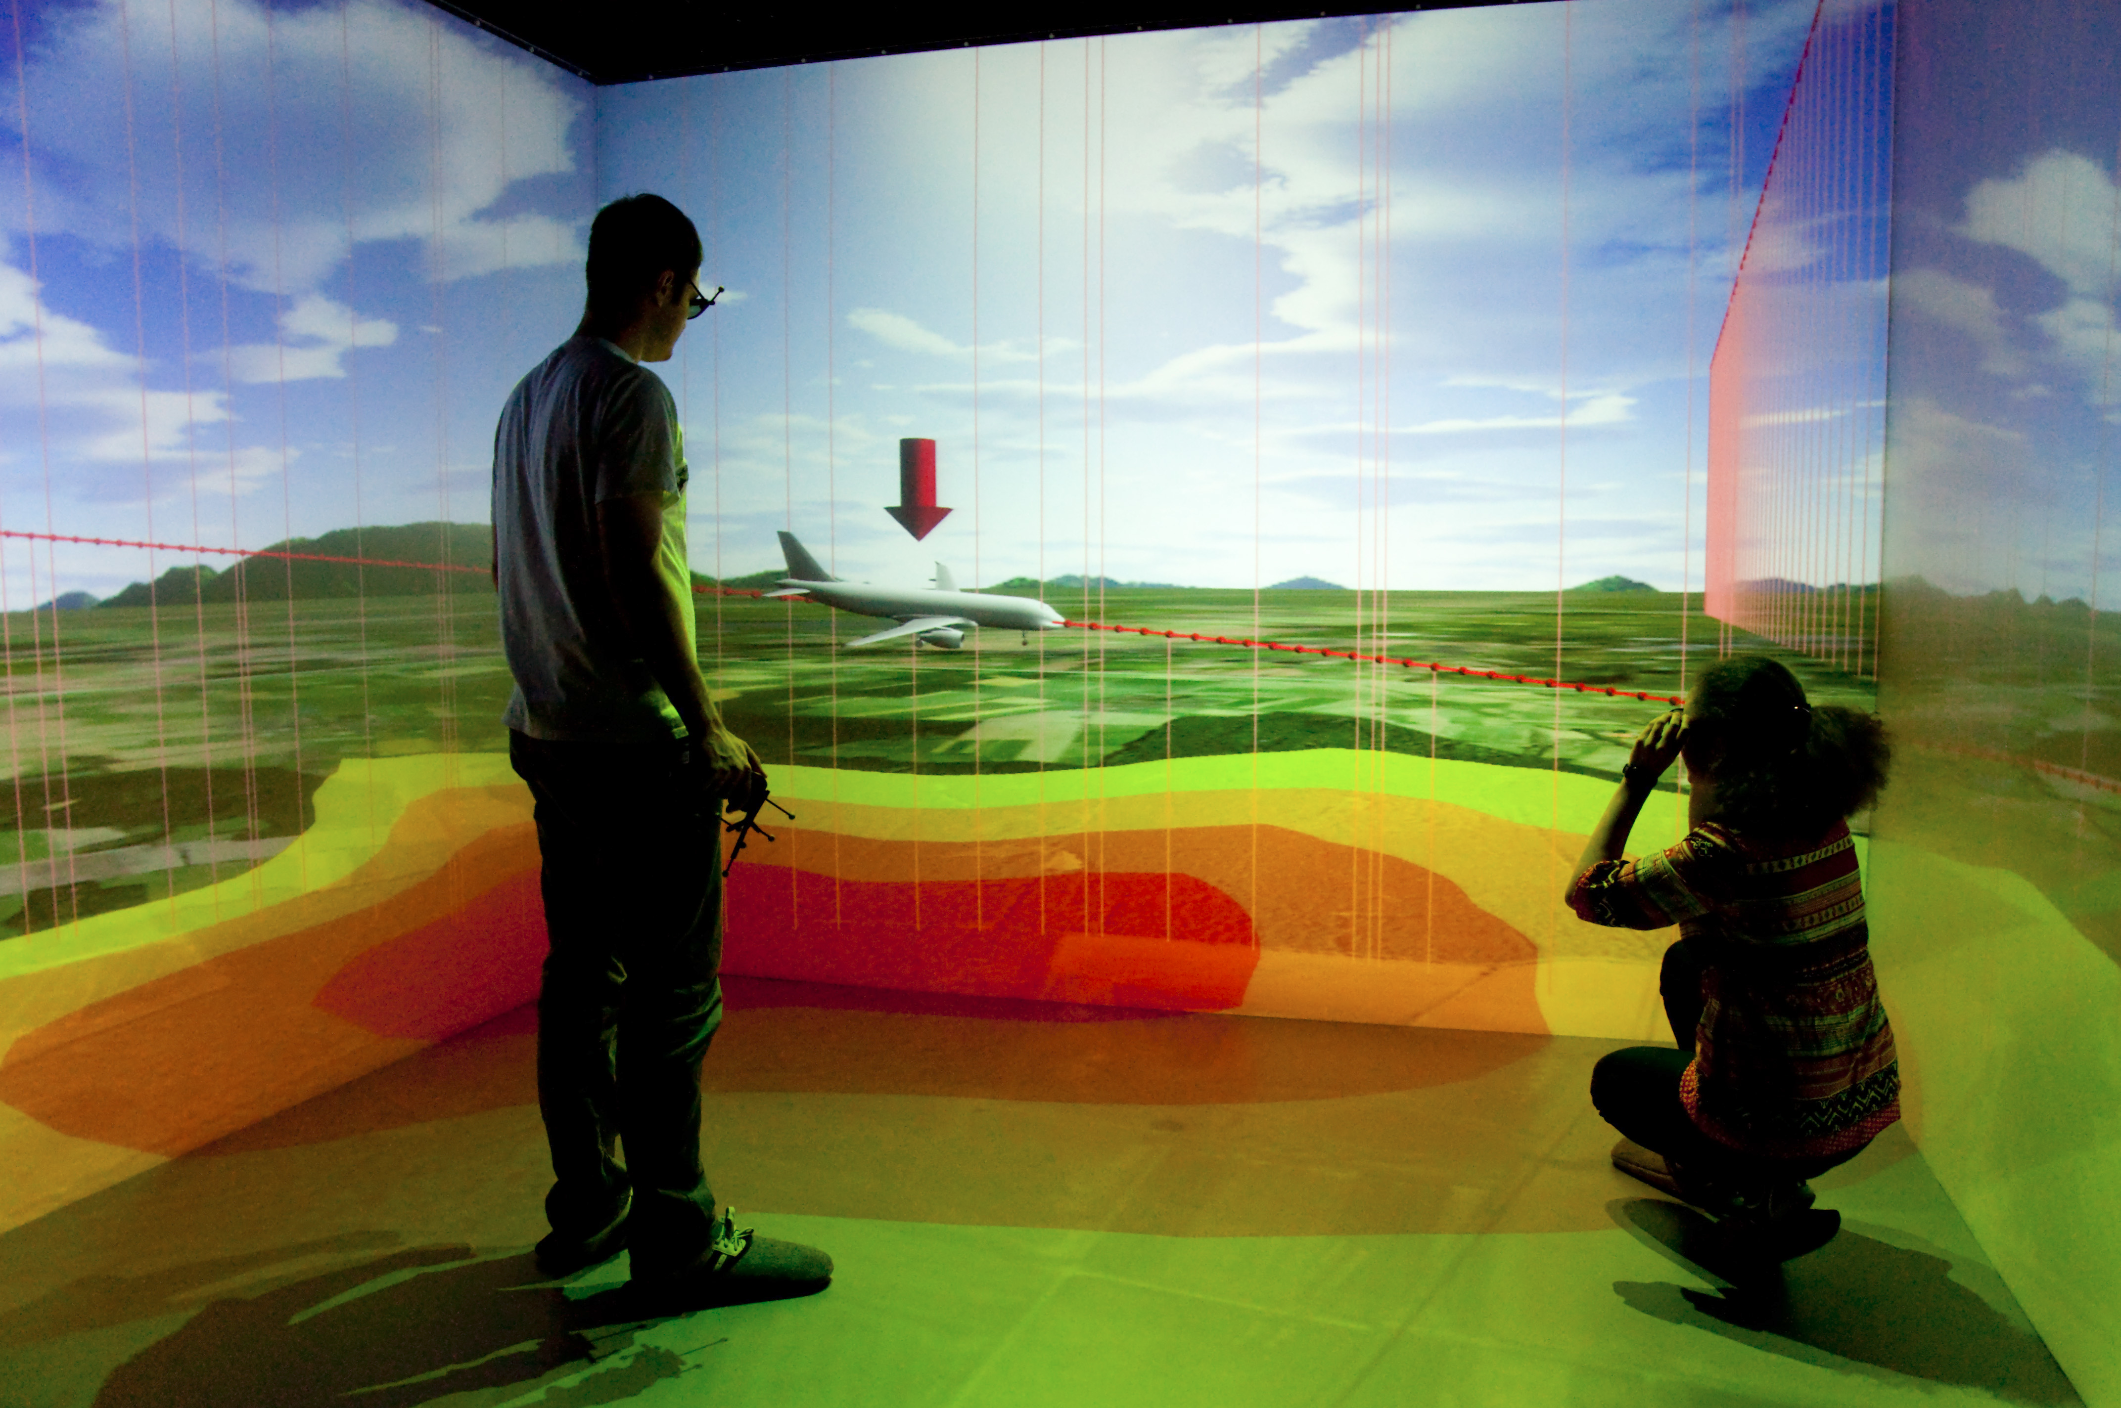
Virtual Environments
Characterized by 3D input and output technologies
Include CAVE and HMD systems
Often utilize 6-DOF devices

Slide 4
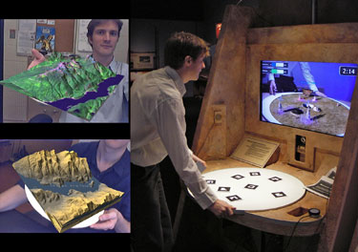
Why create a VE interface?
Allows designers to work in the same environment as users
Two handed interaction
High Bandwidth input
Large screen/ interaction space
Flow and Immersion

Slide 5
Evidence
A number of studies comparing the speed in VEs vs desktop applications
Up to 8x faster with sufficient expertise
Often very simple, general actions
Training is obviously important
Table 2. Training Times in Minutes for the Docking Study.
 | N | Min | Max | Mean | Std. Dev.
Mouse | 20 | 4 | 15 | 9.3 | 2.8
Wand | 20 | 10 | 75 | 32.6 | 17.7
THI | 20 | 20 | 120 | 47.7 | 30.5

Slide 6
VE Interface Design
3 major areas of interest
Navigation, Interface interaction and Environment interaction
Distinct but also tightly related

Slide 7

VE Interface Design - Navigation
Getting from A to B and knowing where those are
Number of methods including flying, walking and teleportation
Ways to help users – Landmarks, maps and sounds
Consider how travel is controlled by the user

Slide 8
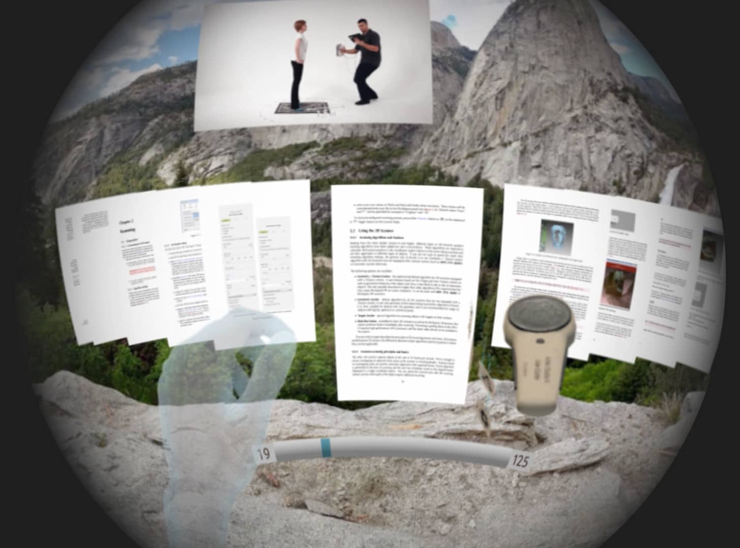
VE Interface Design – Interface Interaction
2D artifacts in a 3D world
Minimize the interface/cognitive layer
Avoid inflated DOF
Menu and widget design
User controls – Joystick, Gesture, Buttons

Slide 9
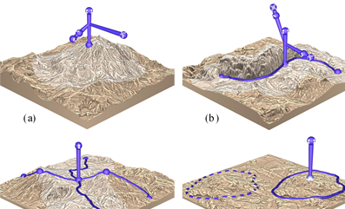
VE Interface Design – Environment Interaction
Handling Depth – Go-Go hand or Raycasting (AAAD)
Bring the world to you
What works with free floating controls – Sketching and Painting

Slide 10
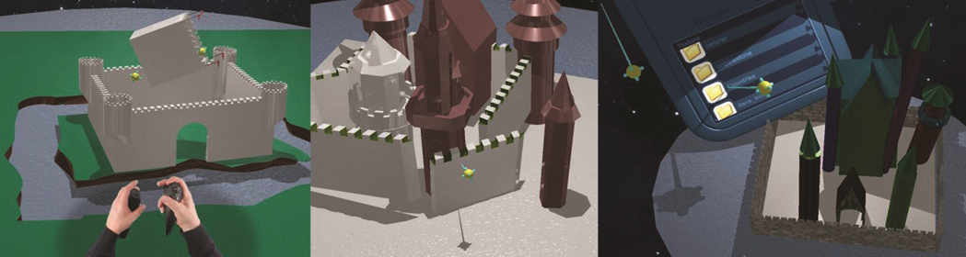
Similar Applications
They exist, albeit using different hardware
Often 1 handed or using custom devices
Small scale, informal or no usability testing
Majority are CAD based

Slide 11
Research question
Is it advantageous to use a VE interface with a HMD and 6-DOF controllers over a WIMP desktop interface for terrain modeling?
Speed
Accuracy
Usability

Slide 12
System Design
Hardware – Oculus Rift + Oculus touch controllers as well as a machine to support this
Software – Interface design to be done in Unity 3D on Windows
Initial Design will be based on existing literature.
User-centered design process
Core philosophies – Prioritize user comfort, utilize natural gestures, Provide shortcuts for experienced users, Design with developer environment in mind

Slide 13
Core Functionalities
Local and Global view
Terrain editing tools
Movement and viewpoint manipulation
Intuitive and usable interface

Slide 14
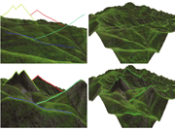
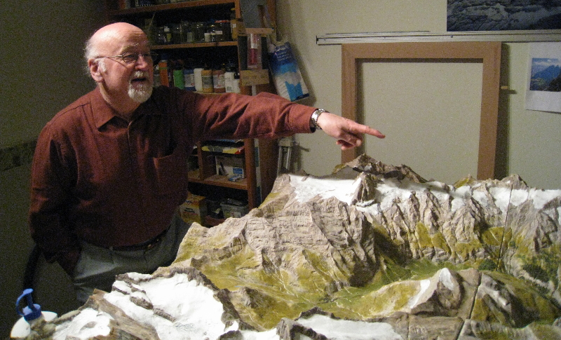
Dual Modes
Allow users to switch between a scene-in-hand god view and an immersive FPV
Allow for quick terrain modeling as well as getting a sense of user experience
Switching between views must be quick but avoid disorientation
Modes must complement each other

Slide 15
Terrain Modeling
Mostly in god-view using widgets and painting
Allow sketching in FPV
Two-Handed widget manipulation
Software support for smooth sketching

Slide 16
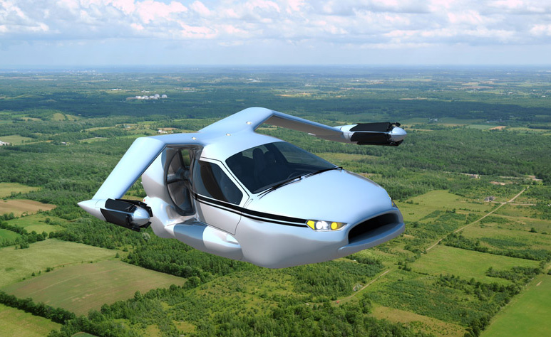
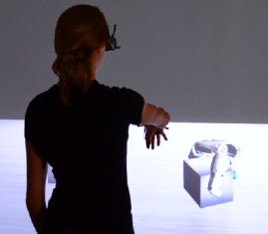
Viewpoint Manipulation
Scene-in-hand for God view
Joystick controlled flying in FPV
In general try keep movement and interaction tasks on separate hands
Model on the fly?

Slide 17
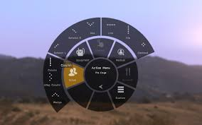
Solving the interface problem
Combination of joystick, button and gestures
Joystick for navigating menus, button for selecting (Joystick press)
Gestures for shortcuts, possibly combined with button presses
Example: Trigger and button lets you grip objects, extending index finger puts you in sketch mode
Some devoted buttons

Slide 18
Experimental Design
Single blind, between-groups
Desktop group vs VE group
Participants selected through convenience sampling by advertising within the CS department
Compromised of two sessions: training and test
Record results via telemetry and questionnaire

Slide 19
Data Analysis
Speed compared using statistical analysis
Accuracy judged by human participants either a small group of experts or using participants of the experiment
Usability assessed using the PSSUQ

Slide 20
Risks
Getting Unity, Oculus hardware and the UTS system to communicate
Networking, VMs, Porting, Alternative software
Creating a real-time application
Smaller terrains
Getting sufficient test subjects
Increase reward, advertise to larger group of students

Slide 21
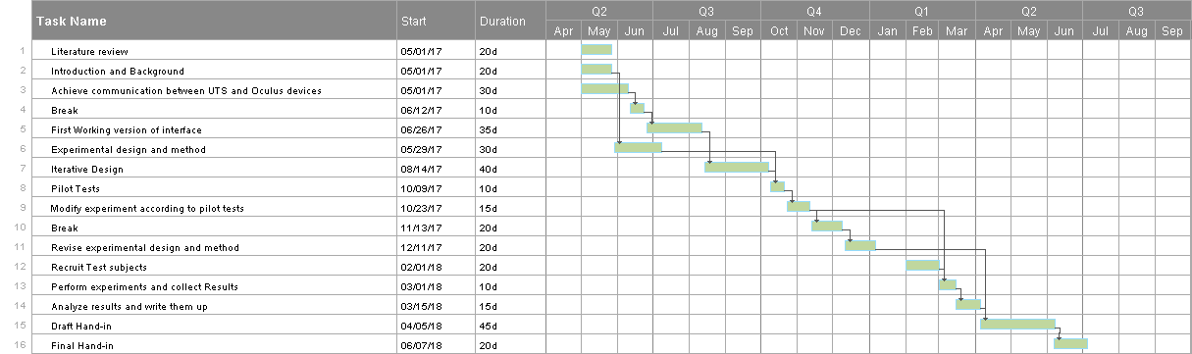
Timetable

